Slide 1


Data Augmentation for Epileptic Seizure Detection based on 3D acceleration, heart rate and temperature
Colloquium for Master’s Thesis by Maleyka Seyidova
Cologne University of Applied Sciences
in cooperation with
Fraunhofer Institute for Software and Systems Engineering
First examiner: Prof. Dr. Beate Rhein, Cologne University of Applied Sciences
Second examiner: M. Sc. Jasmin Henze, Fraunhofer Institute for Software and Systems Engineering
1

Slide 2
Content
Motivation and Objective
Dataset
Method & Implementation
Results & discussion
Conclusion
Outlook

Slide 3
Content
Motivation and Objective
Dataset
Method & Implementation
Results & discussion
Conclusion
Outlook

Slide 4
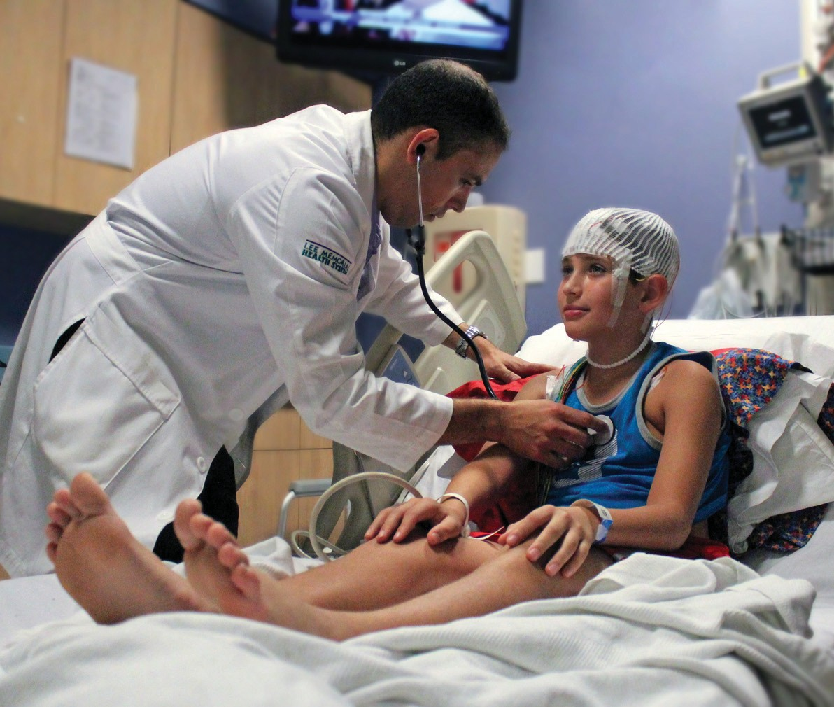
Motivation
Epilepsy
characterized by recurrent seizures
can lead to serious injuries and life-threatening situations
Automated seizure detection systems
documentation & alarm system
requires a large amount of data
Unpredictable nature of seizures
Highly imbalanced dataset
Source: WATSON, JL, and Lee Memorial. “Epilepsy Monitoring Unit Helps Physicians Make Diagnosis While Patients Sleep.” Fort Myers Florida Weekly -, Fort Myers Florida Weekly, 10 Sept. 2014, fortmyers.floridaweekly.com/articles/epilepsy-monitoring-unit-helps-physicians-make-diagnosis-while-patients-sleep/. Accessed 30 May 2023.
‌

Slide 5
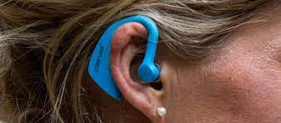
MOND based on the EpiTect
Mobile, smart neurosensory system for the detection and documentation of epileptic seizures in everyday life
3D acceleration
temperature
heart rate - PPG
Source: Houta, Salima, Pinar Bisgin, and Pascal Dulich. "Machine learning methods for detection of Epileptic seizures with long-term wearable devices." Eleventh International Conference on eHealth, Telemedicine, and Social Medicine. 2019.

Slide 6
Objective
Data Augmentation
Increase the amount of available data for MOND – Generate synthetic seizures
Standard Time Series Augmentation
Generative Adversarial Networks
Improve the performance of available seizure detection system
Motoric seizure detection
Seizure sensitivity
False Alarm Rate

Slide 7
Content
Motivation and Objective
Dataset
Method & Implementation
Results & discussion
Conclusion
Outlook

Slide 8
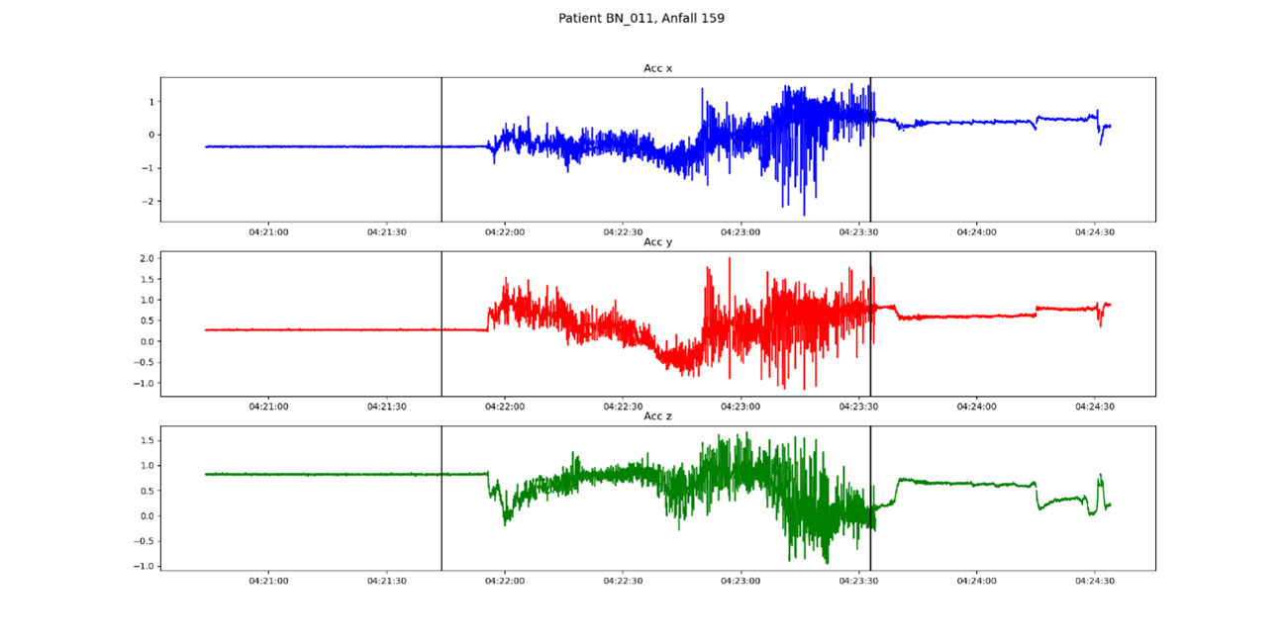
Dataset
3D acceleration (x-axis, y-axis, z-axis)
Sampling frequency: 50Hz
Unit: g

Slide 9
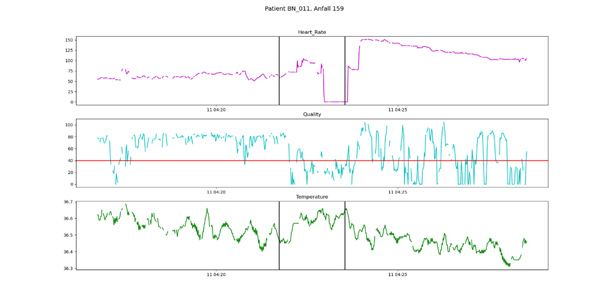
Dataset
Heart rate
Sampling frequency: 1Hz
Unit: bpm
Temperature
Sampling frequency: 1Hz
Unit: °C

Slide 10
Dataset
Dataset - motoric seizures
FIAS – Focal Impaired Awareness Seizure
FAS – Focal Aware Seizure
TCS – Tonic-Clonic Seizure
GMS – Generalized Motor Seizure
Total 109 motoric seizures corresponding to 46 patients
Two datasets
Three-feature dataset: only 3D-acceleration
Five-feature dataset: 3D-acceleration, Heart rate and Temperature

Slide 11
Content
Motivation and Objective
Dataset
Method & Implementation
Results & discussion
Conclusion
Outlook

Slide 12
Method & Implementation
Seizure detection without Data Augmentation
GAN- based Time Series Data Augmentation
Data Preprocessing
Selection of Baseline
Techniques Implementation
EpilepsyGAN
Windowing
Train-Test Split
Three-inputs CNN
Combination
Workflow
Training
Similarity Evaluation
Labeling
Five-inputs CNN
Single Techniques
Workflow
Training
Metrics Monitoring
CNN Architecture
Evaluation
Workflow
TTS-GAN
Standard Time Series Data Augmentation
Seizure Detection with Data Augmentation
Training CNN with Augmented Data

Slide 13
Method & Implementation
Seizure detection without Data Augmentation
GAN- based Time Series Data Augmentation
Data Preprocessing
Selection of Baseline
Techniques Implementation
EpilepsyGAN
Windowing
Train-Test Split
Three-inputs CNN
Combination
Workflow
Training
Similarity Evaluation
Labeling
Five-inputs CNN
Single Techniques
Workflow
Training
Metrics Monitoring
CNN Architecture
Evaluation
Workflow
TTS-GAN
Standard Time Series Data Augmentation
Seizure Detection with Data Augmentation
Training CNN with Augmented Data

Slide 14
Data preprocessing
Five-feature dataset
acc x, acc y, acc z,
heart rate, temperature
Windowing Interpolation
Undersampling Standardization
CNN Training
Epileptic Patients Dataset
Three-feature dataset
acc x, acc y, acc z

Slide 15
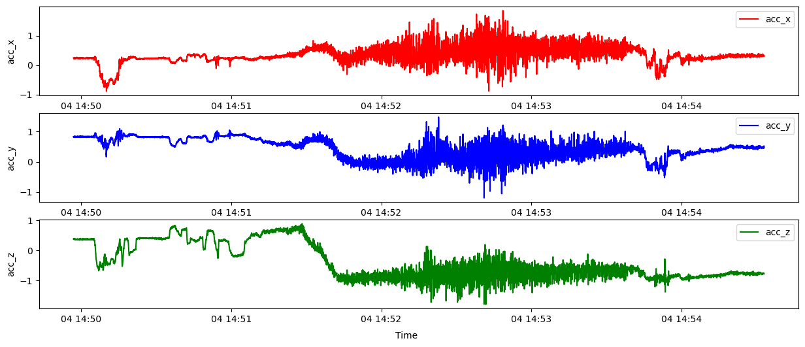
Data preprocessing - Windowing
Total expected values inside the window
3D acceleration: 500 values
Heart rate & Temperature: 10 values
Interpolation threshold: 15%
No overlap
If a window fails in any single feature, all the corresponding windows will also be discarded
10 s window

Slide 16
Data preprocessing - Labelling
Labelling the windows:
if any part of the window lies within the seizure area, the window is labeled as “1:seizure”
else, the window is labeled as “0:non-seizure”
Five-feature dataset
Seizure Types | # of events
FIAS | 54
FAS | 21
TCS | 11
GMS | 2
Three-feature dataset
Seizure Types | # of events
FIAS | 60
FAS | 21
TCS | 11
GMS | 2
Dataset | # of Seizure windows | # of Non-seizure windows
Three- feature | 941 | 648399
Five-feature | 785 | 584737
total: 1626.45 h
seizure: 2.18 h
total: 1803.72 h
seizure: 2.61 h

Slide 17
Data preprocessing – Train-Test split
Train-Test split is done based on the Patients:
Train: 37 patients Test: 9 patients
Test set:
all motoric seizure types
patients with high and low numbers of seizures
Five-feature dataset
Seizure Types | # of events Train | # of events Test
FIAS | 42 | 12
FAS | 18 | 3
TCS | 7 | 4
GMS | 1 | 1
Three-feature dataset
Seizure Types | # of events Train | # of events Test
FIAS | 48 | 12
FAS | 18 | 3
TCS | 7 | 4
GMS | 1 | 1

Slide 18
Data preprocessing – Train-Test split
Train
Train-Test split is done based on the Patients
Train: 37 patients Test: 9 patients
Test set:
all motoric seizure types
patients with high and low numbers of seizures
Dataset | # of Seizure windows | # of Non-seizure windows
Three- feature | 791 | 581295
Five-feature | 660 | 525367
Five-feature dataset
Seizure Types | # of events Train | # of events Test
FIAS | 42 | 12
FAS | 18 | 3
TCS | 7 | 4
GMS | 1 | 1
Three-feature dataset
Seizure Types | # of events Train | # of events Test
FIAS | 48 | 12
FAS | 18 | 3
TCS | 7 | 4
GMS | 1 | 1
Test
Dataset | # of Seizure windows | # of Non-seizure Windows
Three- feature | 150 | 67104
Five-feature | 125 | 59370
Undersampling is applied to the train set to balance the classes
Z-standardization is applied to both train and test set

Slide 19
CNN architecture – CNN with three inputs
Acc x
Acc y
Acc z
Conv1D, 2, 64,ReLU
Conv1D, 2, 64, ReLU
Conv1D, 2, 64, ReLU
Max-Pool, 2
Max-Pool, 2
Max-Pool, 2
Dropout, 0.7
Dropout, 0.7
Dropout, 0.7
Dense, 50, ReLU
Dense, 50, ReLU
Dense, 50 , ReLU
Dropout, 0.7
Dropout, 0.7
Dropout, 0.7
Global Avg. Pool
Global Avg. Pool
Global Avg. Pool
Concatenation
Dense, 2, SoftMax
Seizure (1) / Non-Seizure (0)

Slide 20
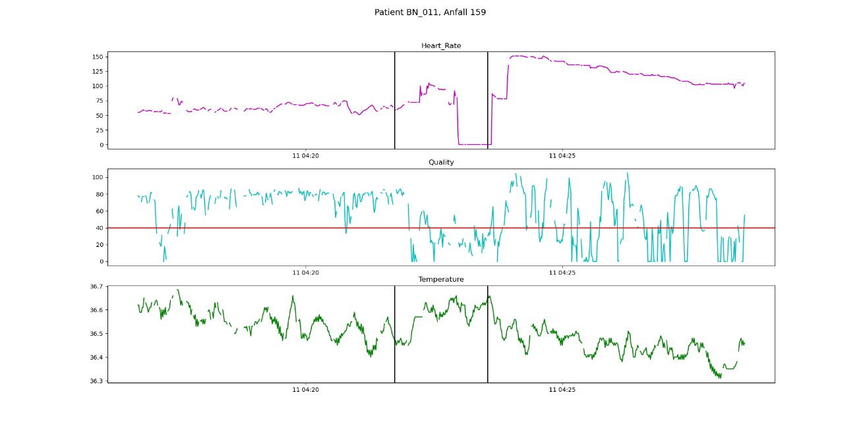
CNN architecture – CNN with five inputs
Acc x
Acc y
Acc z
Heart Rate
Temperature
Conv1D, 2, 64,ReLU
Conv1D, 2, 64, ReLU
Conv1D, 2, 64, ReLU
Conv1D, 2, 64, ReLU
Conv1D, 2, 64, ReLU
Max-Pool, 2
Max-Pool, 2
Max-Pool, 2
Max-Pool, 2
Max-Pool, 2
Dropout, 0.7
Dropout, 0.7
Dropout, 0.7
Dropout, 0.7
Dropout, 0.7
Dense, 50, ReLU
Dense, 50, ReLU
Dense, 50 , ReLU
Dense, 50 , ReLU
Dense, 50 , ReLU
Dropout, 0.7
Dropout, 0.7
Dropout, 0.7
Dropout, 0.7
Dropout, 0.7
Global Avg. Pool
Global Avg. Pool
Global Avg. Pool
Global Avg. Pool
Global Avg. Pool
Concatenation
Dense, 2, SoftMax
Seizure (1) / Non-Seizure (0)
20

Slide 21
Selection of Baseline Model
Binary Cross Entropy
Choice of Loss Function
Baseline
selection
Binary Focal Cross Entropy
Threshold Moving
G-Mean
CNN Model
Sampling
Under-Sampling with different ratios
Additional
experiments
Hyper Band Algorithm
Hyperparameter Tuning
Random Search
21

Slide 22
Evaluation
Seizure Sensitivity – over the whole seizure interval
Window Sensitivity – over individual window
False Alarms per 24 hours (FA/24h)
Specificity
Detected
Not Detected
Detected
1
1
1
0
0
0
0
0
0
0
0
1
0
0
0
0
0
0
1
0
0
Seizure 1
Seizure 2
Seizure 3
22

Slide 23
Seizure detection without Data Augmentation
GAN- based Time Series Data Augmentation
Data Preprocessing
Selection of Baseline
Techniques Implementation
EpilepsyGAN
Windowing
Train-Test Split
Three-inputs CNN
Combination
Workflow
Training
Similarity Evaluation
Labeling
Five-inputs CNN
Single Techniques
Workflow
Training
Metrics Monitoring
CNN Architecture
Evaluation
Workflow
TTS-GAN
Standard Time Series Data Augmentation
Seizure Detection with Data Augmentation
Training CNN with Augmented Data

Slide 24
Time Series Data Augmentation
Jittering
Rotation
Permutation
Standard Data Augmentation Techniques
Time Warping
Magnitude Warping
Permutation + Time Warping
Window Slicing
Rotation + Time Warping
Time Series Data Augmentation
Combination of Techniques
Rotation + Permutation
TTS-GAN
Rotation + Permutation + Time Warping
Generative Adversarial Networks (GANs)
EpilepsyGAN
24

Slide 25
Seizure detection without Data Augmentation
GAN- based Time Series Data Augmentation
Data Preprocessing
Selection of Baseline
Techniques Implementation
EpilepsyGAN
Windowing
Train-Test Split
Three-inputs CNN
Combination
Workflow
Training
Similarity Evaluation
Labeling
Five-inputs CNN
Single Techniques
Workflow
Training
Metrics Monitoring
CNN Architecture
Evaluation
Workflow
TTS-GAN
Standard Time Series Data Augmentation
Seizure Detection with Data Augmentation
Training CNN with Augmented Data

Slide 26
Standard Time Series Data Augmentation - Workflow
Varying sampling frequency of acceleration vs. heart rate, temperature
Some techniques are applied only to acceleration data while keeping the heart rate and temperature original
Some techniques are applied to all features: acceleration data, heart rate, and temperature
Synthetic data
Epileptic Patients Dataset
Extraction of Seizure Events
Applying Augmentation
Synthetic Seizures
10 sec Windowing
CNN Training
Original data
10sec
Windowing

Slide 27
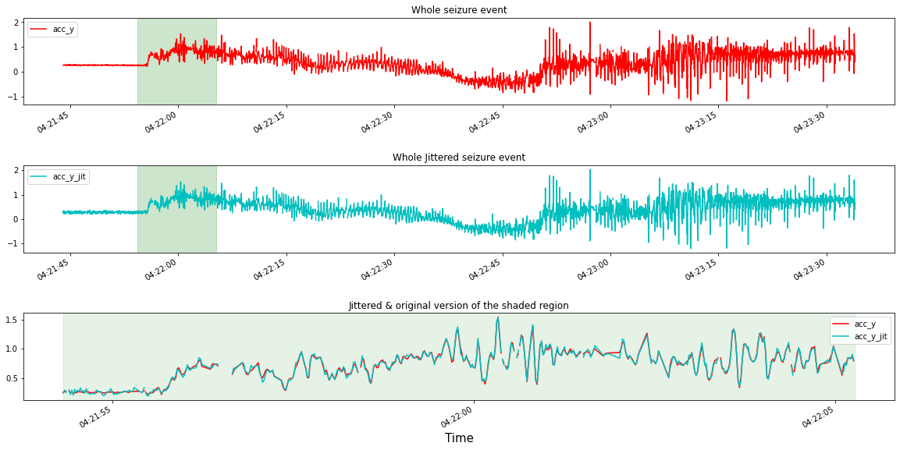
Augmentation with Jittering
Jittering – addition of noise
Std = 0.02 ; 0.05

Slide 28
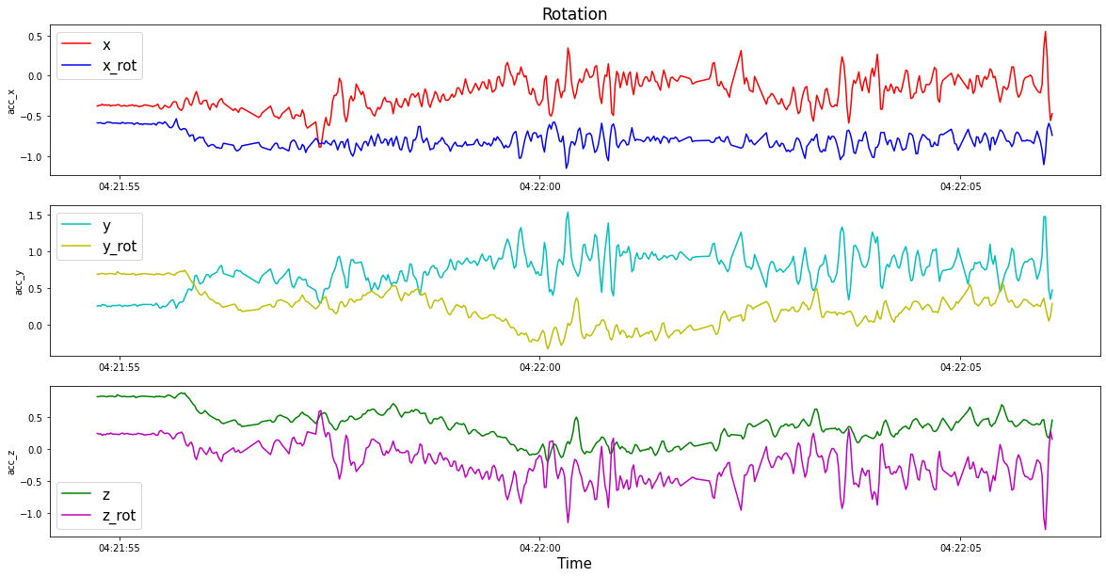
Augmentation with Rotation

Slide 29
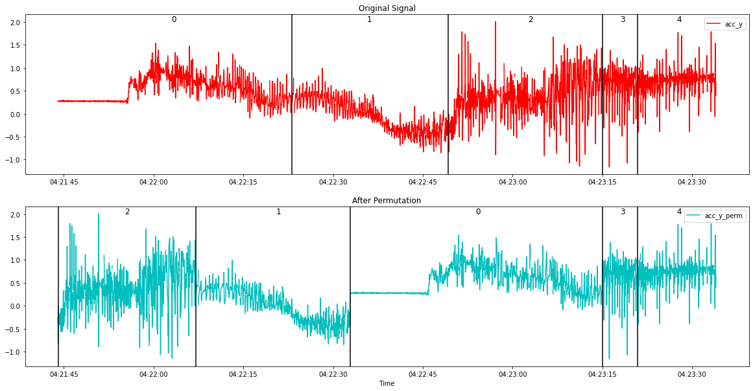
Augmentation with Permutation
Permutation – segmenting the seizure interval and rearranging these segments
Number of segments n=2 ; n=3; n=5

Slide 30
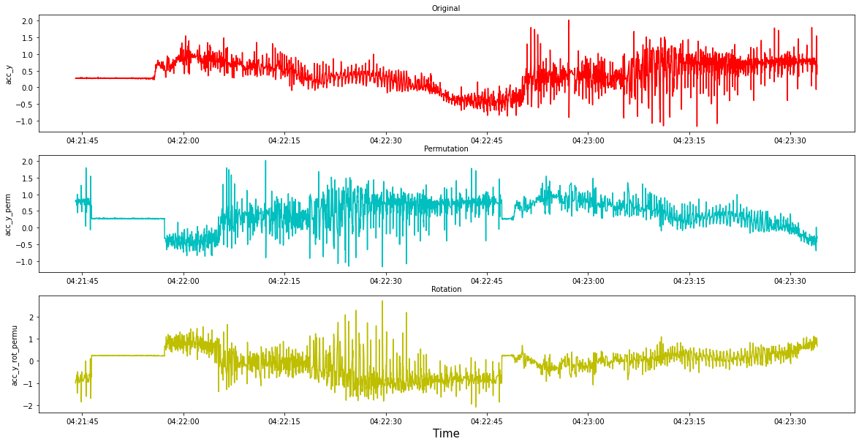
Augmentation with Rotation + Permutation

Slide 31
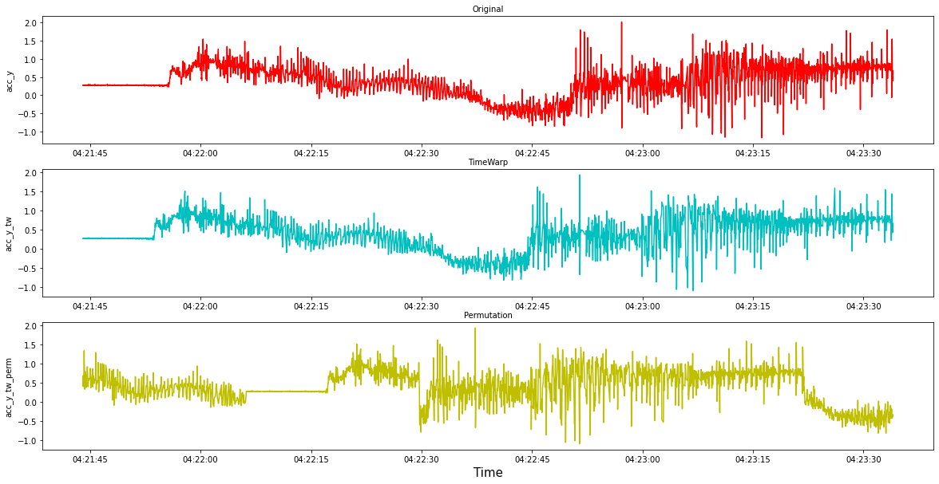
Augmentation with Permutation + Time Warping

Slide 32
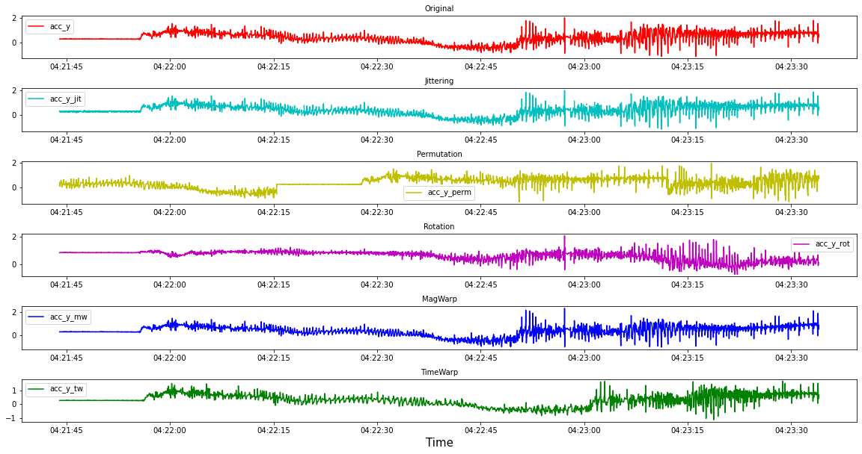
Synthetic samples from each single technique

Slide 33
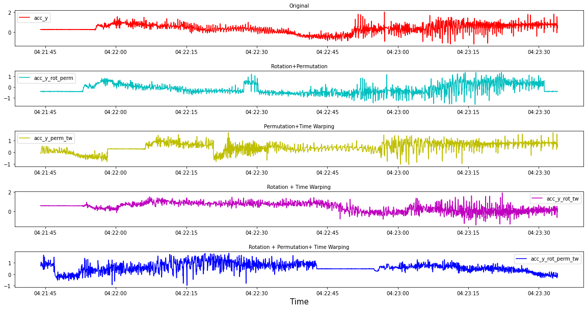
Synthetic samples from combination of techniques

Slide 34
Seizure detection without Data Augmentation
GAN- based Time Series Data Augmentation
Data Preprocessing
Selection of Baseline
Techniques Implementation
EpilepsyGAN
Windowing
Train-Test Split
Three-inputs CNN
Combination
Workflow
Training
Similarity Evaluation
Labeling
Five-inputs CNN
Single Techniques
Workflow
Training
Metrics Monitoring
CNN Architecture
Evaluation
Workflow
TTS-GAN
Standard Time Series Data Augmentation
Seizure Detection with Data Augmentation
Training CNN with Augmented Data

Slide 35
GANS – Workflow
Epileptic Patients dataset
Extraction of seizure Events
Windowing 10s
0% , 50% , 70% overlap
Training
TTS-GAN
Synthetic Seizures data
Extraction of non-seizure Events
Windowing 10s
0% overlap
Training
EpilepsyGAN
Synthetic Seizures data
Synthetic Seizure data = Synthetic 3-D acceleration (x, y, z) seizure samples

Slide 36
GANS – Training
TTS – GAN
EpilepsyGAN
Overlapping | # of Seizure windows
0% | 585
50% | 1113
70% | 1638
Overlapping | # of Seizure windows | # of Seizure & Non-seizure pairs
0% | 525 | 5250
50% | 1009 | 10090
70% | 1484 | 14840

Slide 37
Similarity Evaluation
Dynamic Time Warping (DTW)
Measures the similarity between two-time series signals by finding the optimal alignment of the two signals such that the difference between them is minimized
Cosine Similarity
Calculated between the feature vectors of two time series and measures the similarity by calculating the cosine of the angle between them
Mean Squared Error
Assesses the difference between the real and synthetic values of a time series at each time point. The lower MSE value refers to the higher similarity between the two-time series
PCA and t-SNE
Visualizing the distribution of higher dimensional data in a two-dimensional space

Slide 38
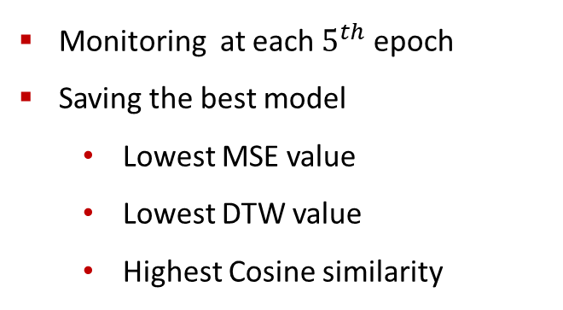
TTS-GAN – Metrics monitoring
Best similarity match between synthetic and real seizures
single synthetic is compared with all real
best match is found – min. DTW, MSE; max. Cos sim
average of all best matches
All real
dtw_1
dtw_2
Synthetic 1
Minimum dtw
Monitoring at each $5^{th}$ epoch
Saving the best model
Lowest MSE value
Lowest DTW value
Highest Cosine similarity
. . .
dtw_N
Average
Final DTW value
. . .
. . .
All real
dtw_1
dtw_2
Synthetic N
Minimum dtw
. . .
dtw_N
38

Slide 39
Training CNN with augmented data
Synthetic data is added to the original training set
Undersampling: the same number of seizures & non-seizures
CNN network is trained with augmented data
Standard Augmentation Techniques
Proportion | # of Seizure windows Five-feature dataset | # of Seizure windows Three-feature dataset
1x | 660 + 490 | 791 + 540
2x | 660 + 980 | 791 + 1080
4x | 660 + 1960 | 791 + 2160
8x | 660 + 3912 | 791 + 4320
GANs
Proportion | # of Seizure windows Three-feature dataset
10% | 791 + 80
30% | 791 + 238
50% | 791 + 396
80% | 791 + 633

Slide 40
Content
Motivation and Objective
Dataset
Methodology
Results & discussion
Conclusion
Outlook

Slide 41
Baseline selection – Choice of the Loss Function
Three – feature dataset
Metrics | bce | bfoce
Seizure Sensitivity | 0.8 | 0.8
FA/24h | 453 | 441
Specificity | 0.8057 | 0.7726
Window Sensitivity | 0.6 | 0.54
Five – feature dataset
Metrics | bce | bfoce
Seizure Sensitivity | 0.9 | 0.85
FA/24h | 382 | 366
Specificity | 0.8085 | 0.8338
Window Sensitivity | 0.696 | 0.68
bce = binary cross entropy , bfoce = binary focal cross entropy, FA/24h = False alarms per 24 hour
41

Slide 42
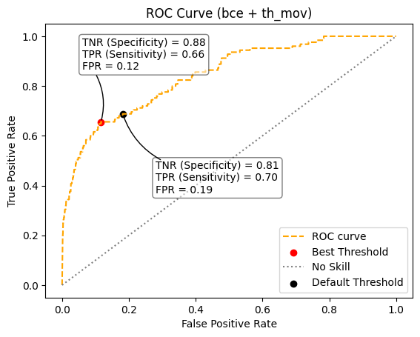
Baseline selection – Threshold Moving
Five-feature dataset
Metrics | bce | bce + th_mv
Seizure Sensitivity | 0.9 | 0.8
FA/24h | 382 | 299
Specificity | 0.8085 | 0.8836
Window Sensitivity | 0.696 | 0.66
bce = binary cross entropy, th_mv = threshold moving
42

Slide 43
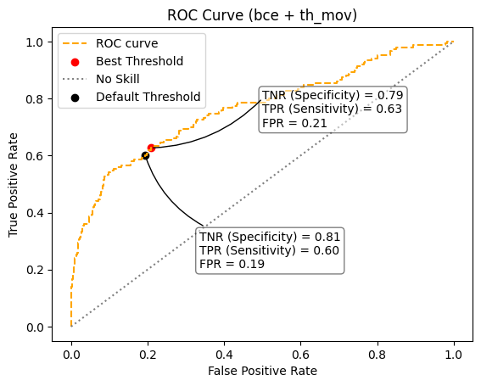
Baseline selection – Threshold Moving
Three-feature dataset
Metrics | bce | bce + th_mv
Seizure Sensitivity | 0.8 | 0.8
FA/24h | 453 | 469
Specificity | 0.8057 | 0.791
Window Sensitivity | 0.6 | 0.63
bce = binary cross entropy, th_mv = threshold moving
43

Slide 44
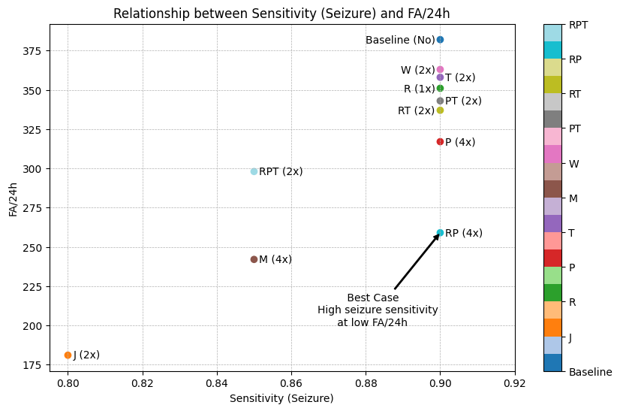
Standard techniques – Five-feature dataset
Technique | FA/24h | Sensitivity seizure
Baseline | 382 | 0.9
Jittering (J) | 181 | 0.8
Rotation (R) | 351 | 0.9
Permutation (P) | 317 | 0.9
Time Warp (T) | 358 | 0.9
Magnitude Warp (M) | 242 | 0.85
Window Slicing (W) | 363 | 0.9
Perm + Time Warp (PT) | 343 | 0.9
Rot + Time Warp (RT) | 337 | 0.9
Rot + Perm (RP) | 259 | 0.9
Rot + Perm + Time Warp (RPT) | 298 | 0.85
44

Slide 45
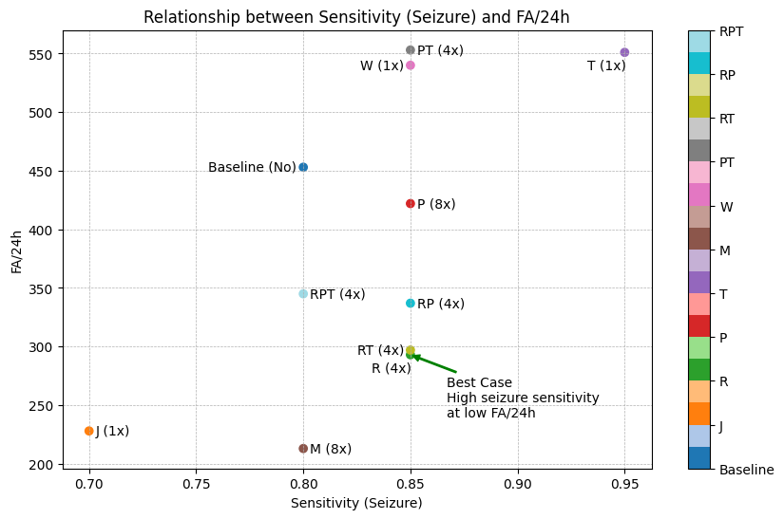
Standard techniques – Three-feature dataset
Technique | FA/24h | Sensitivity seizure
Baseline | 453 | 0.8
Jittering (J) | 228 | 0.7
Rotation (R) | 293 | 0.85
Permutation (P) | 422 | 0.85
Time Warp (T) | 551 | 0.95
Magnitude Warp (M) | 213 | 0.8
Window Slicing (W) | 540 | 0.85
Perm + Time Warp (PT) | 553 | 0.85
Rot + Time Warp (RT) | 297 | 0.85
Rot + Perm (RP) | 337 | 0.85
Rot + Perm + Time Warp (RPT) | 345 | 0.8
45

Slide 46
Comparison of results for Standard techniques
Statement | Three-feature | Five-feature
FA/24h < baseline FA/24h | 7 | All techniques
Sensitivity > baseline Sensitivity | 7 | No technique
Sensitivity = baseline Sensitivity | 2 | 7
Sensitivity < baseline Sensitivity | 1 | 3
Better overall performance* | 6 | 7
Proportions | 4x, 8x | 1x, 2x, 4x
*Higher or same as baseline seizure sensitivity & lower than baseline FA/24h
46

Slide 47
GANs – Selection of Overlap
Best EpilepsyGAN model – data with 70% overlap
Best TTS-GAN model – data with 0% overlap
EpilepsyGAN
Model | FA/24h | Seizure Sensitivity
Baseline | 453 | 0.8
0% Overlap | 158 | 0.65
50% Overlap | 151 | 0.5
70% Overlap | 135 | 0.65
TTS-GAN
Model | FA/24h | Seizure Sensitivity
Baseline | 453 | 0.8
0% Overlap | 207 | 0.7
50% Overlap | 156 | 0.6
70% Overlap | 105 | 0.45
Best models are used to generate synthetic data in 10%, 30%, 50%, 80% proportions for CNN training
47

Slide 48
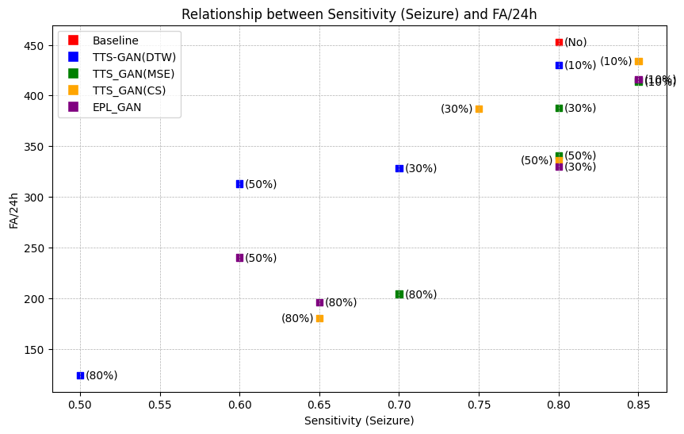
GANs – Comparison of the results
Model | FA/24h | Sensitivity Seizure
Baseline | 453 | 0.8
EpilepsyGAN (30%) | 330 | 0.8
TTS-GAN CS (50%) | 336 | 0.8
EpilepsyGAN (10%) | 416 | 0.85
TTS-GAN MSE (10%) | 414 | 0.85
Only a small proportion of synthetic data yields good results
48

Slide 49
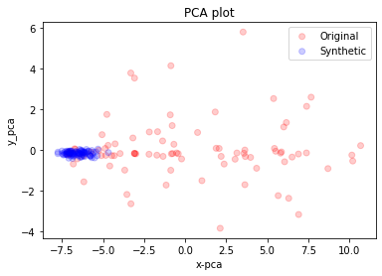
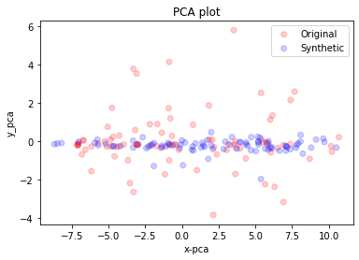
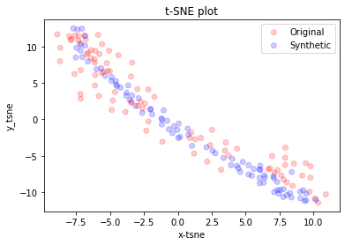
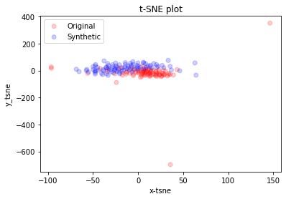
GANs – PCA & t-SNE distribution plots
EpilepsyGAN
TTS-GAN
49

Slide 50
Additional Experiments – Hyperparameter tuning
Hyperparameter tuning with two different tuning algorithms
Five-feature – Seizure sensitivity did not improve, while the False Alarm rate increased
Three-feature – Seizure sensitivity improved at the cost of increased False Alarm rate
Random Search – achieves the highest Seizure sensitivity
Five-feature dataset
Metrics | Baseline | Random Search | Hyperband
Seizure Sensitivity | 0.9 | 0.9 | 0.9
FA/24h | 382 | 631 | 461
Three-feature dataset
Metrics | Baseline | Random Search | Hyperband
Seizure Sensitivity | 0.8 | 0.95 | 0.9
FA/24h | 453 | 575 | 579
50

Slide 51
Additional Experiments – Undersampling with different ratios
Undersampling with increasing class ratios
Seizure sensitivity & False Alarm rate decreased significantly
Five-feature dataset
Ratio | 1:1 | 1:5 | 1:10
Seizure Sensitivity | 0.8 | 0.5 | 0.4
FA/24h | 453 | 84 | 47
Window Sensitivity | 0.696 | 0.352 | 0.282
Specificity | 0.8085 | 0.9733 | 0.9874
51

Slide 52
Content
Motivation and Objective
Dataset
Methodology
Results & discussion
Conclusion
Outlook

Slide 53
Conclusion
The use of binary cross-entropy loss demonstrated better overall performance than using binary focal cross-entropy loss.
Threshold moving showed no better results; it either decreased the seizure sensitivity or caused an increase in the false alarm rate.

Slide 54
Conclusion
In the Five- feature dataset case, the following Standard Augmentation techniques achieved the same Seizure Sensitivity with a reduced False Alarm rate:
Rotation
Permutation
Time Warping
Window Slicing
Permutation + Time Warping
Rotation + Time Warping
Rotation + Permutation
54

Slide 55
Conclusion
In the Five- feature dataset case, the following Standard Augmentation techniques achieved the same Seizure Sensitivity with a reduced False Alarm rate:
Rotation
Permutation
Time Warping
Window Slicing
Permutation + Time Warping
Rotation + Time Warping
Rotation + Permutation
Best Performance
FA/24h: 385 → 259
Seizure sensitivity: 90% (18 of 20 seizure detected)
55

Slide 56
Conclusion
In the Three-feature dataset case, the following standard augmentation techniques achieved the same or higher Seizure Sensitivity with a reduced False Alarm rate:
Rotation
Permutation
Magnitude Warping
Rotation + Time Warping
Rotation + Permutation
Rotation + Permutation + Time Warping

Slide 57
Conclusion
In the Three-feature dataset case, the following standard augmentation techniques achieved the same or higher Seizure Sensitivity with a reduced False Alarm rate:
Rotation
Permutation
Magnitude Warping
Rotation + Time Warping
Rotation + Permutation
Rotation + Permutation + Time Warping
FA/24h: 453 → 293
Seizure sensitivity: 80% (16 of 20 seizure detected) → 85% (17 of 20 seizure detected)
FA/24h: 453 → 213
Seizure sensitivity: 80% (16 of 20 seizure detected)

Slide 58
Conclusion
GAN-generated synthetic data did not outperform those of the standard techniques
Utilizing a small proportion of synthetic data from GANs improved results by achieving the same/higher Seizure Sensitivity with a reduced False Alarm rate:
EpilepsyGAN (30%)
FA/24h: 453 → 330
Seizure sensitivity: 80% (16 of 20 seizures detected)
TTS-GAN MSE (10%)
FA/24h: 453 → 414
Seizure sensitivity: 80% (16 of 20 seizures detected) → 85% (17 of 20 seizures detected)

Slide 59
Additional findings
In the five-feature case: Hyperparameter tuning with Random Search and Hyperband
→ did not improve Seizure sensitivity, increased the False alarm rate
In the three-feature case: Hyperparameter tuning with Random Search and Hyperband
→ increased Seizure sensitivity, increased the False alarm rate
Best-performing - Random Search in a three-feature case
80%
453
Undersampling with different class ratio results in very low seizure detection
→ 95% seizure sensitivity
→ 575 FA/24h

Slide 60
Limitations & Challenges
Limited data, time and computational recourses to explore GANs to the full extent
Large number of hyperparameters & Hyperparameter tuning needs a very long training time
GANs training requires more real seizure data
Different sampling frequencies of the acc data, heart rate and temperature
Adapting GAN architecture to multiple inputs with different frequencies
Applying some Standard Augmentation techniques results in unrealistic values for heart rate & temperature
Lack of research regarding similarity metrics to evaluate time series data
60

Slide 61
Content
Motivation and Objective
Dataset
Methodology
Results
Conclusion
Outlook

Slide 62
Outlook
Accurate seizure detection is critical for reducing risks in epilepsy patients, while a low false alarm rate is desirable for practical use.
→ Diagnosis & Alarm system
In three-feature, Time Warping achieves the highest seizure sensitivity → 95%; 551FA/24h
Comparing Rotation and Magnitude Warping in three-feature case :
Rotation - one more seizure → 17 of 20 seizures detected; 293 FA/24h
Magnitude Warping - 80 fewer false alarms → 16 of 20 seizures detected; 213 FA/24h

Slide 63
Outlook
Additional research could focus on optimizing the hyperparameters of GANs
Other time series GANs may lead to higher-quality synthetic seizure data
Evaluating the effect of augmentation on a bigger test set
Investigating the relationship between the type of seizure and the model’s performance via extensive test set = model’s effectiveness in detecting specific types of seizures
Exploring if augmentation influences a particular type of seizure detection
related to sample pattern
Data quality

Slide 64
Thank you For Your Attention!

Slide 65
References
Image Sources:
WATSON, JL, and Lee Memorial. “Epilepsy Monitoring Unit Helps Physicians Make Diagnosis While Patients Sleep.” Fort Myers Florida Weekly -, Fort Myers Florida Weekly, 10 Sept. 2014, fortmyers.floridaweekly.com/articles/epilepsy-monitoring-unit-helps-physicians-make-diagnosis-while-patients-sleep/. Accessed 30 May 2023.
Houta, Salima, Pinar Bisgin, and Pascal Dulich. "Machine learning methods for detection of Epileptic seizures with long-term wearable devices." Eleventh International Conference on eHealth, Telemedicine, and Social Medicine. 2019.
“MOND -Mobile, Smart Neurosensor System for the Detection and Documentation of Epileptic Seizures in Everyday Life.” Fraunhofer Institute for Software and Systems Engineering, 2020, www.isst.fraunhofer.de/en/business-units/healthcare/projects/MOND.html. Accessed 30 May 2023.
“Papers with Code - DTW Explained.” Paperswithcode.com, 2014, paperswithcode.com/method/dtw. Accessed 30 May 2023.
Rosebrock, Adrian. “Building an Image Search Engine: Defining Your Similarity Metric (Step 3 of 4) - PyImageSearch.” PyImageSearch, 17 Feb. 2014, pyimagesearch.com/2014/02/17/building-an-image-search-engine-defining-your-similarity-metric-step-3-of-4/. Accessed 30 May 2023.
Gupta, Aryan. “Mean Squared Error : Overview, Examples, Concepts and More.” Simplilearn.com, Simplilearn, 15 Dec. 2021, www.simplilearn.com/tutorials/statistics-tutorial/mean-squared-error. Accessed 30 May 2023.
Convolutional Neural Networks:
Meisel, Christian et al. “Machine learning from wristband sensor data for wearable, noninvasive seizure forecasting.” Epilepsia vol. 61,12 (2020): 2653-2666. doi:10.1111/epi.16719
Böring, Jannik. "Implementierung eines Convolutional Neural Networks zur Detektion motorischer epileptischer Anfälle mittels Biosignalen eines In-Ohr-Sensors", 2021.
Generative Adversarial Networks:
Li, Xiaomin, et al. "Tts-gan: A transformer-based time-series generative adversarial network." Artificial Intelligence in Medicine: 20th International Conference on Artificial Intelligence in Medicine, AIME 2022, Halifax, NS, Canada, June 14–17, 2022, Proceedings. Cham: Springer International Publishing, 2022.
Pascual, Damian, et al. "Epilepsygan: Synthetic epileptic brain activities with privacy preservation." IEEE Transactions on Biomedical Engineering 68.8 (2020): 2435-2446.
Standard Augmentation Techniques
Iwana, Brian Kenji, and Seiichi Uchida. "An empirical survey of data augmentation for time series classification with neural networks." Plos one 16.7 (2021): e0254841.
Um, Terry T., et al. "Data augmentation of wearable sensor data for parkinson’s disease monitoring using convolutional neural networks." Proceedings of the 19th ACM international conference on multimodal interaction. 2017.

Slide 66
References
“Epilepsy Foundation.” Epilepsy Foundation, 2023, www.epilepsy.com/. Accessed 30 May 2023.
“Welcome to the International League against Epilepsy.” Ilae.org, 2017, www.ilae.org/. Accessed 30 May 2023.
MOND PROJECT, https://www.isst.fraunhofer.de/de/geschaeftsfelder/gesundheitswesen/projekte/MOND.html. Accessed 23 March 2023.
Henze, Jasmin, et al. "Multimodal detection of tonic–clonic seizures based on 3D acceleration and heart rate data from an in-ear sensor." Pattern Recognition. ICPR International Workshops and Challenges: Virtual Event, January 10–15, 2021, Proceedings, Part I. Springer International Publishing, 2021.
Beniczky, Sándor, and Philippe Ryvlin. “Standards for testing and clinical validation of seizure detection devices.” Epilepsia vol. 59 Suppl 1 (2018): 9-13. doi:10.1111/epi.14049
Sun, Yanmin, Andrew KC Wong, and Mohamed S. Kamel. "Classification of imbalanced data: A review." International journal of pattern recognition and artificial intelligence 23.04 (2009): 687-719.
He, Haibo, and Edwardo A. Garcia. "Learning from imbalanced data." IEEE Transactions on knowledge and data engineering 21.9 (2009): 1263-1284.
Brownlee, Jason. “A Gentle Introduction to Threshold-Moving for Imbalanced Classification - MachineLearningMastery.com.” MachineLearningMastery.com, 9 Feb. 2020, machinelearningmastery.com/threshold-moving-for-imbalanced-classification/. Accessed 23 March 2023.
Lin, Tsung-Yi, et al. "Focal loss for dense object detection." Proceedings of the IEEE international conference on computer vision. 2017.
Brownlee, Jason. “A Gentle Introduction to Cross-Entropy for Machine Learning - MachineLearningMastery.com.” MachineLearningMastery.com, 20 Oct. 2019, machinelearningmastery.com/cross-entropy-for-machine-learning/. Accessed 6 May 2023.
Wold, Svante, Kim Esbensen, and Paul Geladi. "Principal component analysis." Chemometrics and intelligent laboratory systems 2.1-3 (1987): 37-52.
Van der Maaten, Laurens, and Geoffrey Hinton. "Visualizing data using t-SNE." Journal of machine learning research 9.11 (2008).
Bergstra, James, and Yoshua Bengio. "Random search for hyper-parameter optimization." Journal of machine learning research 13.2 (2012).
Li, Lisha, et al. "Efficient hyperparameter optimization and infinitely many armed bandits." CoRR, abs/1603.06560 16 (2016).

Slide 68
Backup Slides

Slide 69
Metrics

Slide 70
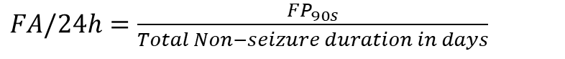
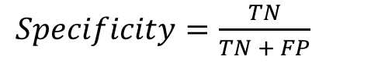
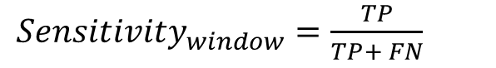
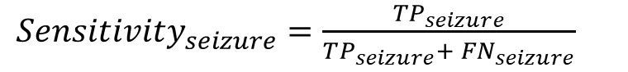
Evaluation
Seizure Sensitivity – over the whole seizure interval
Window Sensitivity – over individual window
Specificity
False Alarms per 24 hours (FA/24h)
${Sensitivity}_{seizure}=\frac{TP_{seizure}}{TP_{seizure}+ FN_{seizure}}$
${Sensitivity}_{window}=\frac{TP}{TP+ FN}$
$Specificity=\frac{TN}{TN + FP}$
$FA/24h=\frac{FP_{90s}}{Total Non−seizure duration in days}$
Detected
Not Detected
Detected
1
1
1
0
0
0
0
0
0
0
0
1
0
0
0
0
0
0
1
0
0
Seizure 1
Seizure 2
Seizure 3
70

Slide 71
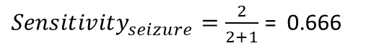
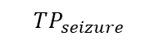
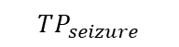
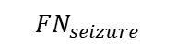
Evaluation
Seizure Sensitivity – over the whole seizure interval
${Sensitivity}_{seizure}=\frac{TP_{seizure}}{TP_{seizure}+ FN_{seizure}}$
$$TP_{seizure}$$
$${FN}_{seizure}$$
$$TP_{seizure}$$
1
Detected
Not Detected
Detected
0
${Sensitivity}_{seizure}=\frac{2}{2+1}$ = 0.666
Seizure 1
Seizure 2
Seizure 3
71

Slide 72
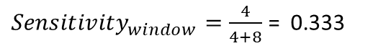
Evaluation
Seizure Sensitivity – over the whole seizure interval
Window Sensitivity – over individual window
${Sensitivity}_{window}=\frac{TP}{TP+ FN}$
1
Detected
Not Detected
Detected
TP
TP
TP
FN
FN
FN
FN
0
FN
FN
TP
FN
FN
${Sensitivity}_{window}=\frac{4}{4+8}$ = 0.333
Seizure 1
Seizure 2
Seizure 3
72

Slide 73
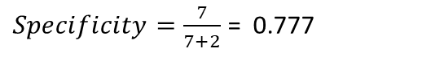
Evaluation
Seizure Sensitivity – over the whole seizure interval
Window Sensitivity – over individual window
Specificity
$Specificity=\frac{TN}{TN + FP}$
1
0
TN
TN
TN
TN
FP
TN
TN
FP
TN
$Specificity=\frac{7}{7+2}$ = 0.777
Seizure 1
Seizure 2
Seizure 3
73

Slide 74
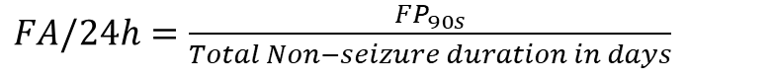
Evaluation
Seizure Sensitivity – over the whole seizure interval
Window Sensitivity – over individual window
Specificity
False Alarms per 24 hours (FA/24h)
Base on average seizure interval (approx. 90s)
Total Non-seizure duration in days $= \frac{\left(no. of Non−seizure windows ∗ 10\right)}{60 ∗ 60 ∗ 24}$
$FA/24h=\frac{FP_{90s}}{Total Non−seizure duration in days}$
74

Slide 75
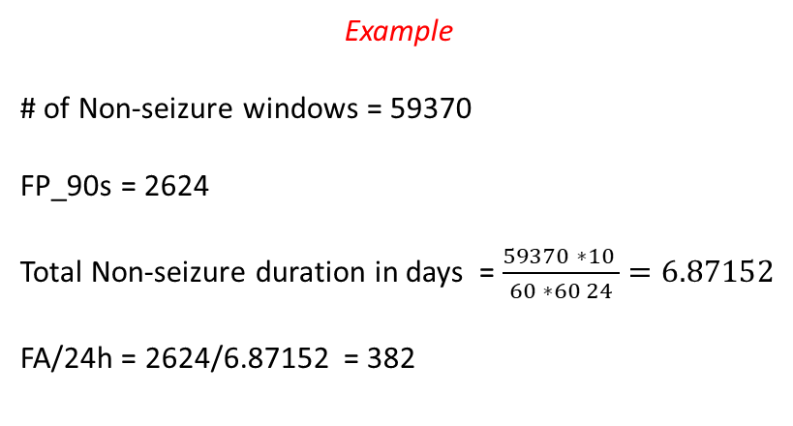
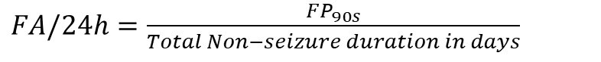
Evaluation
Seizure Sensitivity – over the whole seizure interval
Window Sensitivity – over individual window
Specificity
False Alarms per 24 hours (FA/24h)
Example
# of Non-seizure windows = 59370
FP_90s = 2624
Total Non-seizure duration in days = $\frac{59370 ∗10 }{60 ∗60 24}=6.87152$
FA/24h = 2624/6.87152 = 382
$FA/24h=\frac{FP_{90s}}{Total Non−seizure duration in days}$
90 seconds interval
1 1 1 1 1 1 1 1 1
1 1 0 1 0 0 1
1 1 1 1 1 1
1 1 1 1 1 1 1 1
Time (t)
FA / FP_90s
No FA / TN_90s
FP_90s
FP_90s
75

Slide 76
Why FA/24h is lower while having lower specificity
90 seconds interval
4 non-seizure windows correctly classified, 0 FA/24h
0 1 1 1
0 1 1 1
1 1 1 0
0 1 1 1
Low specificity at low FA/24h
No FA
No FA
No FA
No FA
Time (t)
8 non-seizure windows correctly classified, 2 FA/24h
1 1 1 1
0 0 0 0
0 0 0 0
1 1 1 1
High specificity at High FA/24h
FA
No FA
No FA
FA
Time (t)

Slide 77
Comparison between Seizure sensitivity and Sample Sensitivity
Model 1
Model 2
Seizure Interval 1
Seizure Interval 2
Seizure Interval 1
Seizure Interval 2
detected
Not detected
detected
detected
Detected 10s Window
Non - Detected 10s Window
Seizure detected = 1 of 2
Window detected = 3 of 7
Seizure detected = 2 of 2
Window detected = 2 of 7
Low seizure sensitivity
High Sample/window sensitivity
High seizure sensitivity
Low Sample/window sensitivity

Slide 78
Hyperparameter

Slide 79
Hyperparameter Intervals
Hyperparameter | Interval
No. of filters | 32, 64, 128, 256
Filter size | Min=2 , Max =10 , Step size = 1
Size of Pooling | Min=2 , Max =10 , Step size = 1
Dropout rate | Min=0.2 , Max =0.9 , Step size = 0.1
Number of Conv1D, Pooling, Dropout group | Min=1 , Max =4 , Step size = 1
Learning rate | 0.01, 0.001, 0.0001
Dense layer neurons | Min=20 , Max =100, Step size = 10
79

Slide 80
G-mean

Slide 81
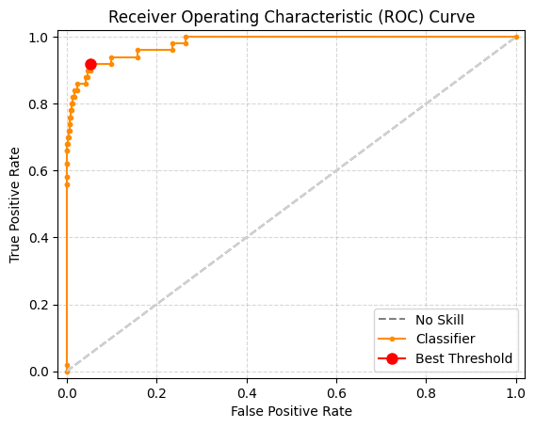
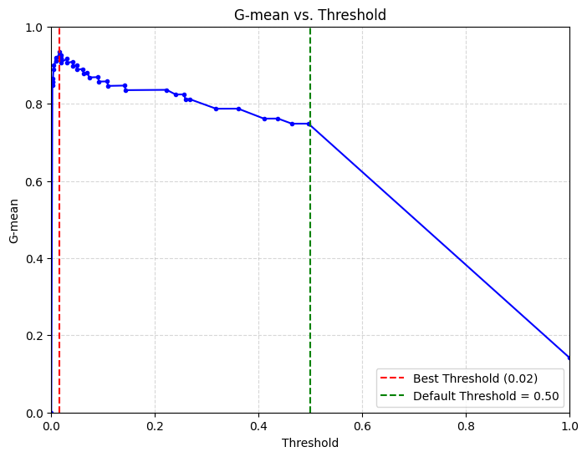
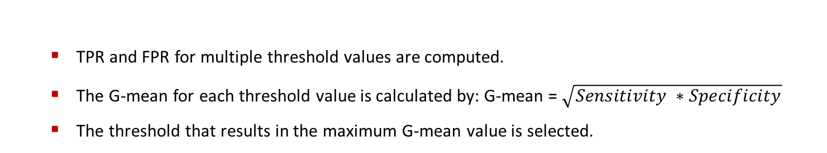
Threshold Moving
TPR and FPR for multiple threshold values are computed.
The G-mean for each threshold value is calculated by: G-mean = $\sqrt{Sensitivity ∗Specificity}$
The threshold that results in the maximum G-mean value is selected.
Sensitivity = True Positive Rate
Specificity = 1- False Positive Rate
False Positive Rate = FP/FP+TN

Slide 82
GANs

Slide 83
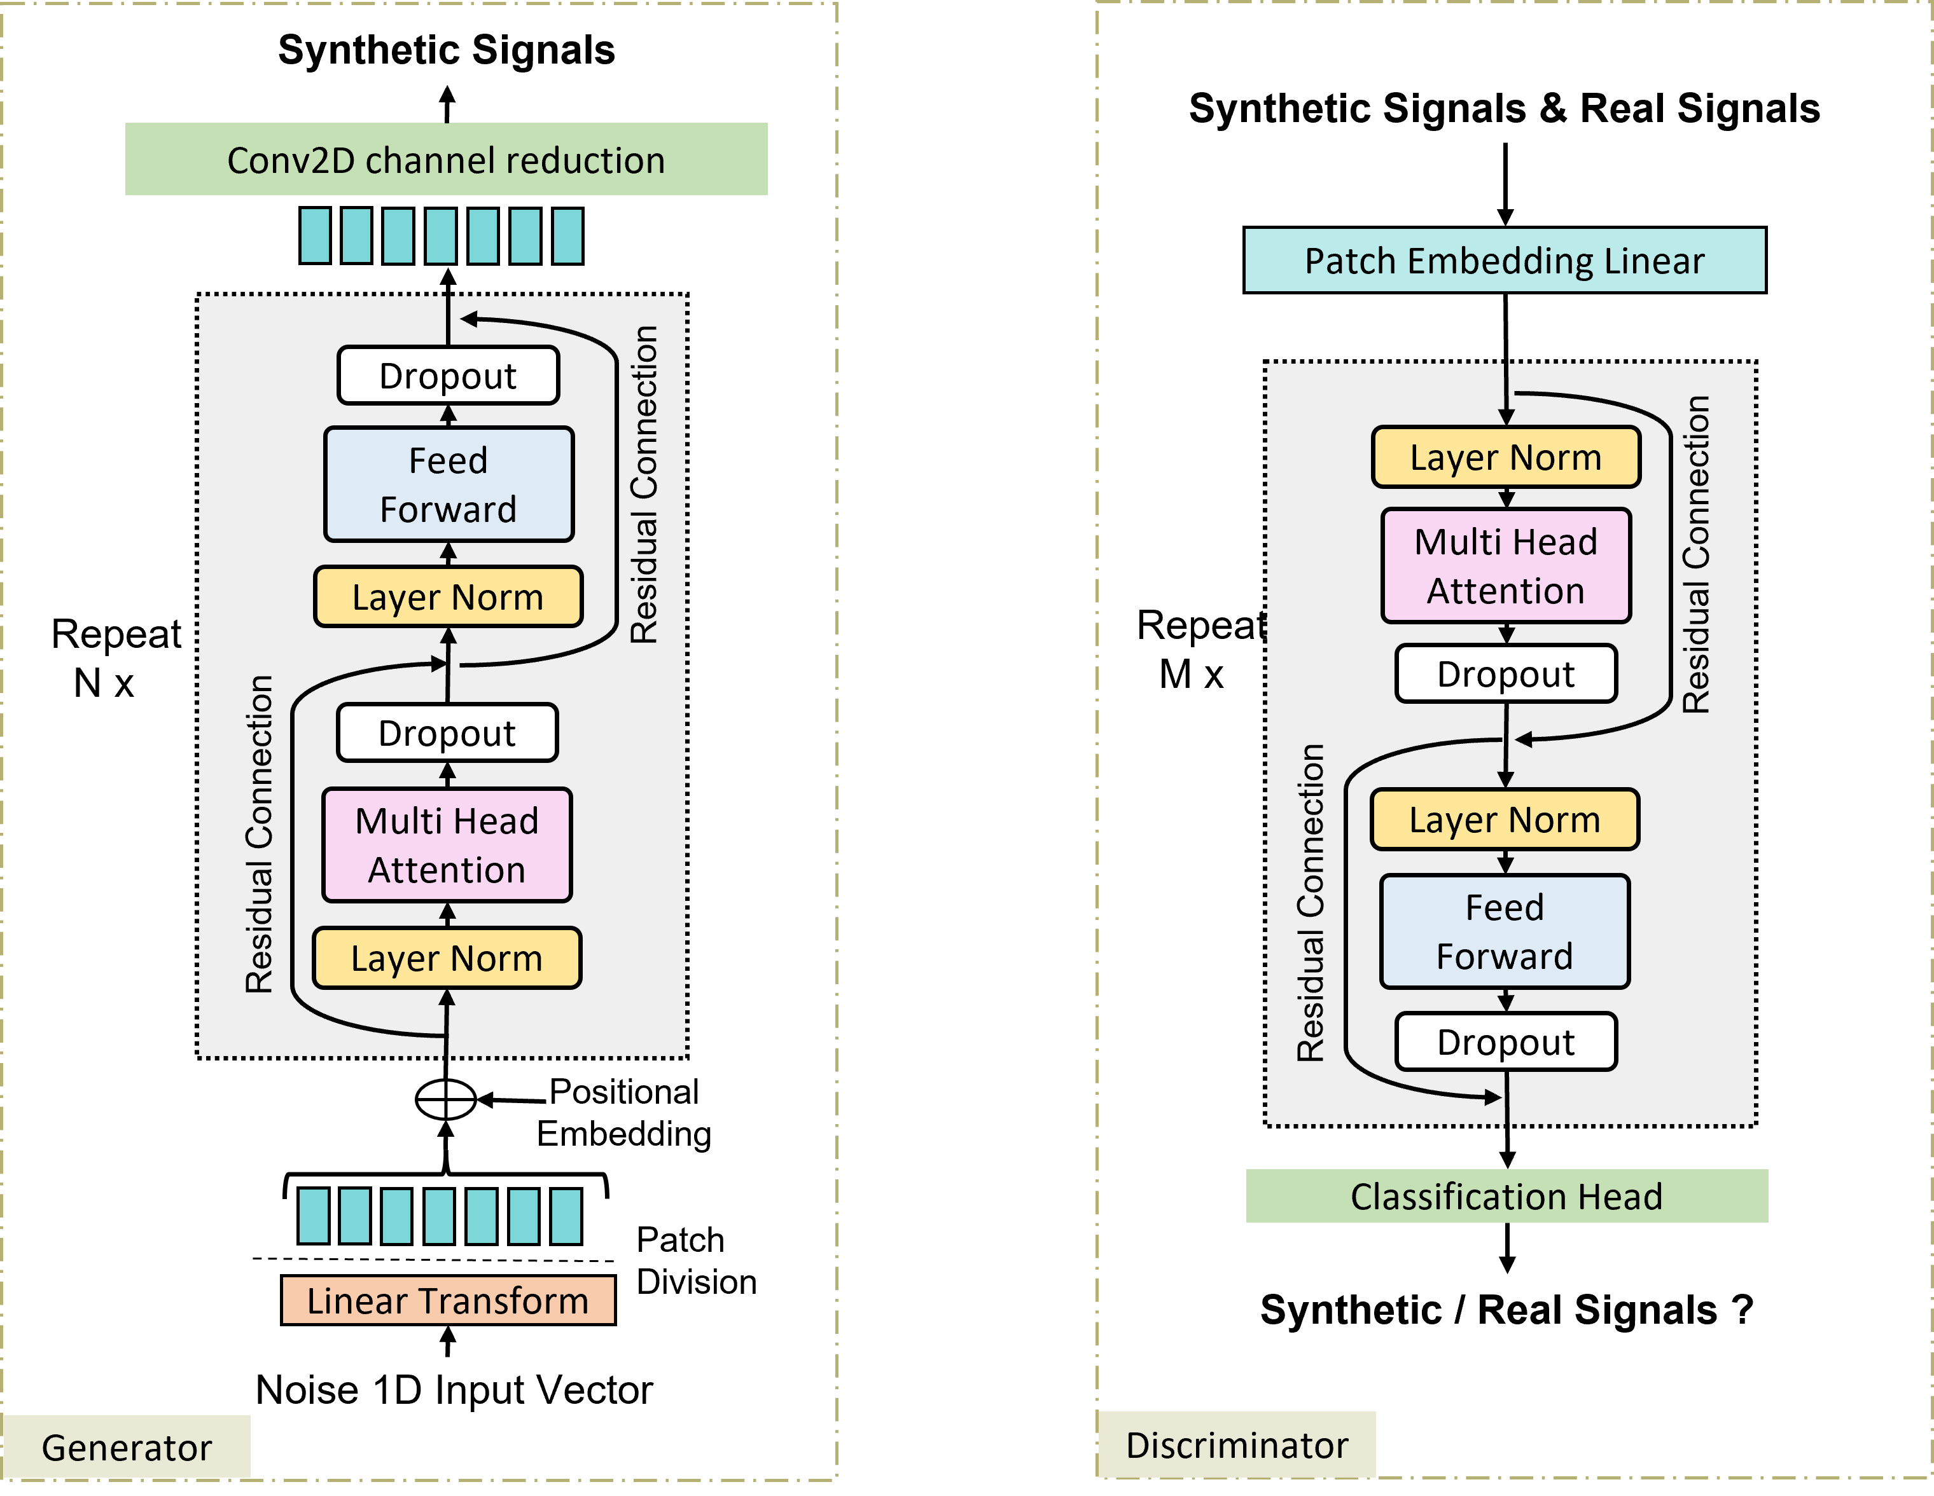
TTS-GAN - Network architecture
Based on Source: Li, Xiaomin, et al. "Tts-gan: A transformer-based time-series generative adversarial network." Artificial Intelligence in Medicine: 20th International Conference on Artificial Intelligence in Medicine, AIME 2022, Halifax, NS, Canada, June 14–17, 2022, Proceedings. Cham: Springer International Publishing, 2022.

Slide 84
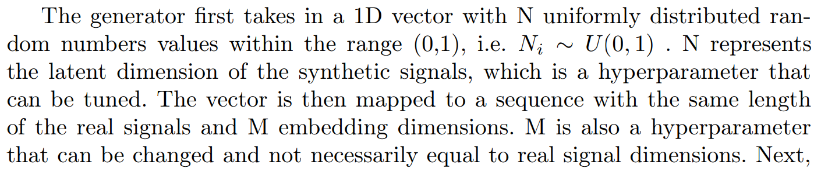
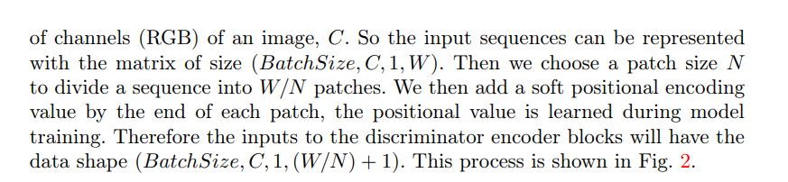
Latent Dimension: The latent dimension refers to a size of the noise vector consisting of random variables generated from a random normal (Gaussian) distribution. This noise vector serves as the input to the generator in a GAN architecture. In our case it is 500 -> (*, 500)
Embedding Dimension: The embedding dimension refers to the size of the vector space in which the input data is projected or embedded. It plays a crucial role in shaping the dimensionality of the learned representations and affects the model's capacity to capture and represent complex patterns in the data.
In the context of transformers, the embedding dimension refers to the size of the vector space in which words (or in this case, patches of the time-series data) are embedded. E.g (*, 500) -> (*,seq_len x emb_dim) -> (*, 500 x 10) -> (*,500,10)
Patch Size: The patch size refers to the dimensions of the patches that are extracted from the input. This division allows the discriminator to analyze the time-series data in a localized manner.
In the context of transformers applied to images or time-series data, the input is often divided into patches. Each patch is then processed independently by the transformer. This approach allows the model to handle larger inputs and learn local and global patterns.

Slide 85
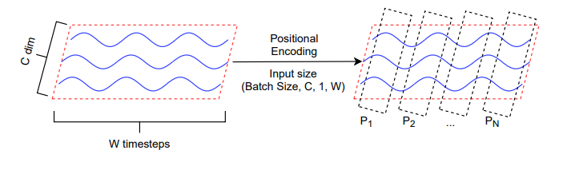
Positional Encoding: Soft positional encoding values are added to the end of each patch. These positional values are learned during model training and help the model differentiate between different positions within each patch. The positional encoding ensures that the model can capture temporal relationships and dependencies between the timesteps

Slide 86
TTS-GAN - Workflow
DATASET
Original Train set
Original Test set
Seizures
Seizures
Training
TTS-GAN
Random noise
Trained TTS - GAN
Synthetic Seizures Data
Similarity Evaluation
Synthetic Seizures Data
Original Seizure & non-Seizure
CNN-Training
Evaluation

Slide 87
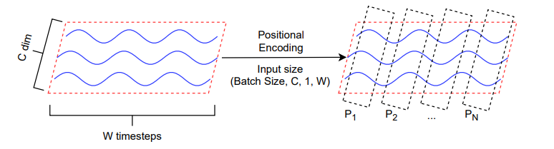
TTS-GAN – Training
Activation function: GeLU
Optimizer: Adam
Batch size: 8; epochs: 500
Lr generator: 0.0001 ; Lr discriminator: 0.0003
Loss function: MSE (Mean Squared Error)
Hyperparameters:
Embedding dimension: 10
Latent dimension: 100
Patch size: 50
Source: Li, Xiaomin, et al. "Tts-gan: A transformer-based time-series generative adversarial network." Artificial Intelligence in Medicine: 20th International Conference on Artificial Intelligence in Medicine, AIME 2022, Halifax, NS, Canada, June 14–17, 2022, Proceedings. Cham: Springer International Publishing, 2022.
Overlapping | # of Seizure windows
0% | 585
50% | 1113
70% | 1638

Slide 88
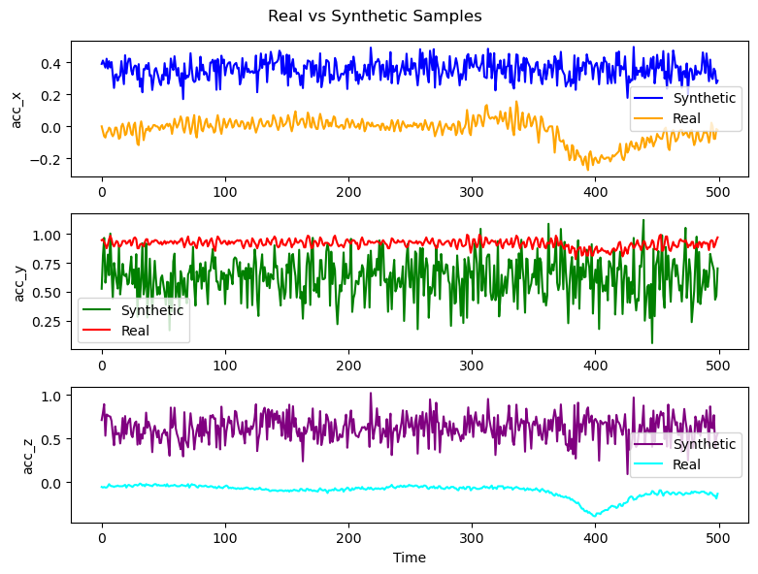
TTS-GAN

Slide 89
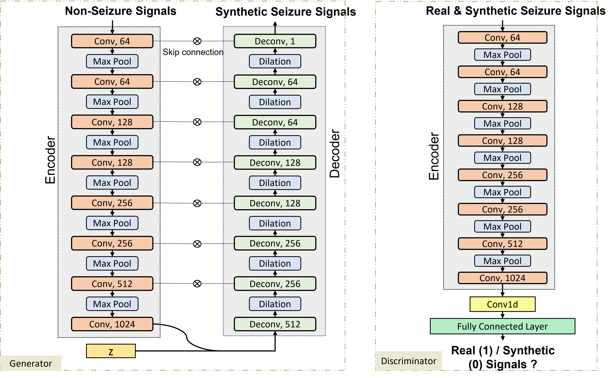
Epilepsy GAN - Network architecture
Based on source: Pascual, Damian, et al. "Epilepsygan: Synthetic epileptic brain activities with privacy preservation." IEEE Transactions on Biomedical Engineering 68.8 (2020): 2435-2446.

Slide 90
Real
Real
Non-Seizures
Seizures
Non- Seizure
Seizure
Patient 1
…
Synthetic
GAN
Seizures
Patient i-1
Patient i
Patient i+1
CNN Model Training
…
Training
Patient N
Training set GAN

Slide 91
Epilepsy GAN - Workflow
Dataset
Training Patients Data
Test Patients Data
Seizures
Non-Seizures
Seizures
Non-Seizures
A
B
Pairing
Training Epilepsy GAN
Trained Epilepsy GAN
Trained Epilepsy GAN
Similarity Evaluation
Synthetic Seizures
Seizures
Synthetic Seizures
Original Seizure & non-Seizure
CNN-Training

Slide 92
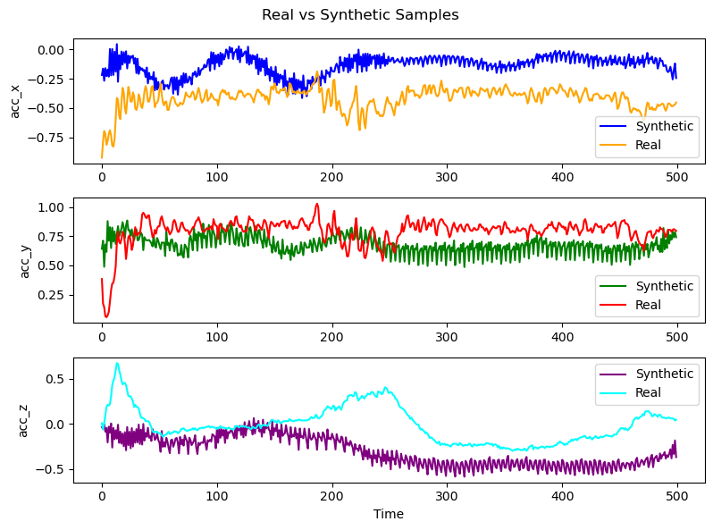
EpilepsyGAN

Slide 93
Epilepsy GAN – Training
Activation function: leaky ReLu
Optimizer: Adam
Batch size: 100; epochs: 100
Lr generator: 0.0001 ; Lr discriminator: 0.0004
Loss function: LSGAN (Least Squares GAN)
Regularization: L1 , λ: 100
Overlapping | # of Seizure windows | # of Seizure & Non-seizure pairs
0% | 525 | 5250
50% | 1009 | 10090
70% | 1484 | 14840

Slide 94
CNN

Slide 95
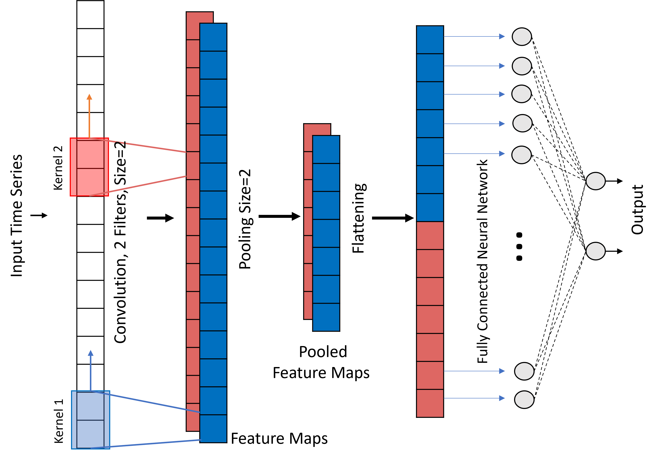
CNN architecture – illustration of 1D CNN
Based on Source: Böring, Jannik. "Implementierung eines Convolutional Neural Networks zur Detektion motorischer epileptischer Anfälle mittels Biosignalen eines In-Ohr-Sensors", 2021.

Slide 96
If window fails, next window starts after 1 second.

Slide 97
Training of CNN
Activation function: ReLU, Softmax
Optimizer: Adam
Batch size: 2048; epochs: 2000
Learning rate: scheduled with Learning rate scheduler function from Keras API
Loss function: binary cross-entropy, binary-focal cross-entropy
Dropout: 0.7 is used for regularization

Slide 98
Training of CNN
Activation function: ReLU, Softmax
Optimizer: Adam
Batch size: 32; epochs: 2000
Learning rate: scheduled with Learning rate scheduler function from Keras API
Loss function: binary cross-entropy, binary-focal cross-entropy
Dropout: 0.7 is used for regularization
Data distribution in the five-feature dataset
84% train: 660 seizure & non-seizure windows
16% test: 125 seizure windows
Data distribution in a three-feature dataset
84% train: 791 seizure & non-seizure windows
16% test: 150 seizure windows

Slide 99
SIMILARITY

Slide 100
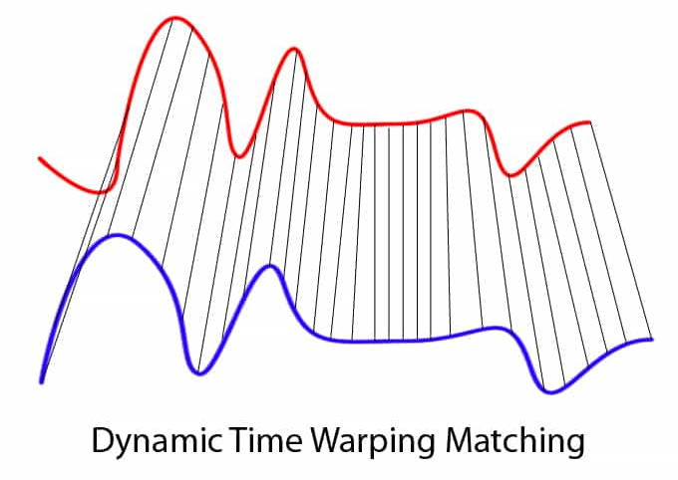
Similarity Evaluation
Dynamic Time Warping (DTW)
Measures the similarity between two-time series signals by finding the optimal alignment of the two signals such that the difference between them is minimized
Source: “Papers with Code - DTW Explained.” Paperswithcode.com, 2014, paperswithcode.com/method/dtw. Accessed 30 May 2023.
‌

Slide 101
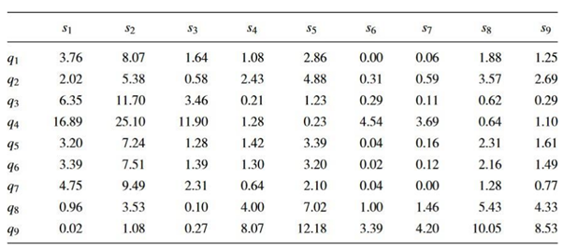

Similarity Evaluation
Dynamic Time Warping (DTW) – Calculation
Distance Matrix – Distance between each corresponding point from two time series
Euclidean distance → $d\left(q,s\right)= \sqrt{{(q}_{i} −s_{j})^{2} }$
Source: Shou, Yutao, Nikos Mamoulis, and David W. Cheung. "Fast and exact warping of time
series using adaptive segmental approximations." Machine Learning 58.2-3 (2005): 231.

Slide 102

Similarity Evaluation
Dynamic Time Warping (DTW) – Calculation
Distance Matrix – Distance between each corresponding point from two time series
Warping Matrix /Cost Matrix
$$D\left(i,j\right)=\min\left(D\left(i−1, j−1\right) , D\left(i−1, j\right), D\left(i,j−1\right)\right)+d(i,j)$$
Source: Shou, Yutao, Nikos Mamoulis, and David W. Cheung. "Fast and exact warping of time
series using adaptive segmental approximations." Machine Learning 58.2-3 (2005): 231.

Slide 103

Similarity Evaluation
Dynamic Time Warping (DTW) – Calculation
Distance Matrix – Distance between each corresponding point from two time series
Warping Matrix – Cost spent
DTW is calculated for each pair of real and synthetic samples and then the average is taken
$$avg_dtw{= \frac{1}{n} \sum_{i=1}^{n}{(DTW_{i})}}$$

Slide 104
Similarity Evaluation
Dynamic Time Warping (DTW) – Calculation
Distance Matrix – Distance between each corresponding point from two time series
Warping Matrix – Cost spent
DTW is calculated for each pair of real and synthetic samples and then the average is taken
Values between 0 – max. real DTW

Slide 105

Similarity Evaluation
Dynamic Time Warping (DTW)
Cosine Similarity
Calculated between the feature vectors of two time series and measures the similarity by calculating the cosine of the angle between them
Source: Rosebrock, Adrian. “Building an Image Search Engine: Defining Your Similarity Metric (Step 3 of 4) - PyImageSearch.” PyImageSearch, 17 Feb. 2014, pyimagesearch.com/2014/02/17/building-an-image-search-engine-defining-your-similarity-metric-step-3-of-4/. Accessed 30 May 2023.
‌

Slide 106
Similarity Evaluation
Dynamic Time Warping (DTW)
Cosine Similarity – Calculation
Seven statistical features are calculated for each real and synthetic sample;
median, mean, standard deviation, variance, root mean square, maximum, and minimum

Slide 107


Similarity Evaluation
Dynamic Time Warping (DTW)
Cosine Similarity – Calculation
Seven statistical features are calculated for each real and synthetic sample;
median, mean, standard deviation, variance, root mean square, maximum, and minimum
Cosine similarity is calculated for each pair of real and synthetic feature vectors then the average is taken
$$cos_sim_{ab}{= \frac{f_{a} . f_{b}}{\left|\left|f_{a}\right|\right|+||f_{b}||}}$$
$$avg_cos_sim{= \frac{1}{n} \sum_{i=1}^{n}{({cos⁡_sim}_{i})}}$$

Slide 108
Similarity Evaluation
Dynamic Time Warping (DTW)
Cosine Similarity – Calculation
Seven statistical features are calculated for each real and synthetic sample;
median, mean, standard deviation, variance, root mean square, maximum, and minimum
Cosine similarity is calculated for each pair of real and synthetic feature vectors then the average is taken
Values between -1 and 1

Slide 109

Similarity Evaluation
Dynamic Time Warping (DTW)
Cosine Similarity
Mean Squared Error
Assesses the difference between the real and synthetic values / (value-wise comparison) of a time series at each time point. The lower MSE value refers to the higher similarity between the two-time series
Source: Gupta, Aryan. “Mean Squared Error : Overview, Examples, Concepts and More.” Simplilearn.com, Simplilearn, 15 Dec. 2021, www.simplilearn.com/tutorials/statistics-tutorial/mean-squared-error. Accessed 30 May 2023.
‌

Slide 110


Similarity Evaluation
Dynamic Time Warping (DTW)
Cosine Similarity
Mean Squared Error – Calculation
Calculated for each pair of real and synthetic samples and then the average is taken
$$MSE_{ab}{= \frac{1}{n} \sum_{i=1}^{n}{{\left(R_{ai}−S_{bi}\right)}^{2}}}$$
$$avg_mse{= \frac{1}{n} \sum_{i=1}^{n}{({MSE}_{i})}}$$

Slide 111
Similarity Evaluation
Dynamic Time Warping (DTW)
Cosine Similarity
Mean Squared Error – Calculation
Calculated for each pair of real and synthetic samples and then the average is taken
Values between 0 and 1

Slide 112
Similarity Evaluation
Dynamic Time Warping (DTW)
Cosine Similarity
Mean Squared Error
PCA and t-SNE
Visualizing the distribution of higher dimensional data in a two-dimensional space

Slide 113


Slide 114
EXTRA

Slide 115



Synthetic Signals
Conv2D channel reduction
Dropout
Feed Forward
Layer Norm
Repeat
N x
Dropout
Multi Head Attention
Layer Norm
Positional Embedding
Patch Division
Linear Transform
Noise 1D Input Vector
Generator

Slide 116


Synthetic Signals & Real Signals
Patch Embedding Linear
Layer Norm
Multi Head Attention
Repeat
M x
Dropout
Layer Norm
Feed Forward
Dropout
Classification Head
Synthetic / Real Signals ?
Discriminator

Slide 117
Comparison of results for Standard techniques
Statement | Three-feature | Five-feature
FA/24h < baseline FA/24h | 7 | All techniques
Sensitivity > baseline Sensitivity | 7 | No technique
Sensitivity = baseline Sensitivity | 2 | 7
Sensitivity < baseline Sensitivity | 1 | 3
Better overall performance* | 6 | 7
Proportions | 4x, 8x | 1x, 2x, 4x
Except Time Warping, no technique with a three-feature dataset achieved higher seizure sensitivity than the same technique in five-feature dataset
Time Warping with three-feature dataset yields the higher seizure sensitivity (0.95) than it does in five-feature case, at the cost of a much higher false alarm rate
Rotation, Rotation + Time Warping, and Magnitude Warping result in lower FA/24h in three-feature case, while all others give lower FA/24h in five-feature case
*Higher or same as baseline seizure sensitivity & lower than baseline FA/24h
117

Slide 118

Window sensitivity vs. Specificity in five-feature dataset

Slide 119

Window sensitivity vs. Specificity in three-feature dataset

Slide 120


Loss Curves 5-feat
BCE
BFOCE

Slide 121


Loss Curves 3-feat
BCE
BFOCE

Slide 122
Even though with the use of data augmentation the seizure sensitivity is higher and the
false alarm rate is lower as compared to the baseline model (model results without augmentation),
the model is still not suitable for usage in practice. The false alarm rate is still
too high; 12 alarms per hour (R) and 9 alarms per hour (M) for the model trained along
with data from the best-performing augmentation techniques in three-feature case. In the
five-feature case, the best-performing technique (RP) yields 11 false alarms per hour.

Slide 123
Input
Filter
Output
14
50
2
118
10
1
2*50 + 1 * 10 + 4*11
154
11
4
83
13
195
40

